Slide 1


SRI KRISHNA COLLEGE OF ENGINEERING AND TECHNOLOGY
23IT601 PRINCIPLES OF COMMUNICATION SYSTEMS

Slide 2

MODULE-1
SRI KRISHNA COLLEGE OF ENGINEERING AND TECHNOLOGY
Introduction to Communication Systems & Angle Modulation

Slide 3
Communication
Communication is the transfer of information from one place to another.
This should be done
as efficiently as possible
with as much fidelity/reliability as possible
as securely as possible
Communication System: Components/subsystems act together to accomplish information transfer/exchange.

Slide 4
Elements of Communication
The five basic components of electronic communications system are the transmitter, communications channel or medium, receiver, and noise, message.
Analog signals (such human voice) or digital signals (binary data) are inputted to the system, processed in the electronic circuits for transmission, and then decoded by the receiver.

Slide 5
Blocks of Electronic Communication
Information source
Transmitter
Channel
Receiver
Destination
Noise source

Slide 6
Information Source
Information Source: Audio, image, text, data.
Input Transducer: Converts source to electric signal
Microphone
Camera
Keyboard
Output Transducer: Converts electric signal to usable form
Speaker
Monitor

Slide 7
Transmitter
Transmitter: Converts electrical signal into form suitable for channel
Modulator
Amplifier
Filtering and encoding (if necessary)

Slide 8
Channel
Medium used to transfer signal from transmitter to receiver. Point to point or Broadcast
Wire lines
Fiber optic cable
Atmosphere
Often adds noise / weakens & distorts signal

Slide 9
Receiver
Extracts an estimate of the original transducer output
Demodulator
Filtering
Amplifier
Transceivers
A transceiver is an electronic unit that incorporates circuits that both send and receive signals.
Examples are:
Telephones
Fax machines
Handheld CB radios
Cell phones
Computer modems

Slide 10
Noise source
Attenuation
Signal attenuation, or degradation, exists in all media of wireless transmission. It is proportional to the square of the distance between the transmitter and receiver.
Noise
Noise is random, undesirable electronic energy that enters the communication system via the communicating medium and interferes with the transmitted message.

Slide 11
Types of Electronic Communication
Electronic communications are classified according to whether they are
One-way (simplex) or two-way (full duplex or half duplex) transmissions - point to point channels. Broadcasts messages to all connected receivers – Multipoint
Analog or digital signals.

Slide 12
Simplex
The simplest method of electronic communication is referred to as simplex.
This type of communication is one-way. Examples are:
Radio
TV broadcasting
Beeper (personal receiver)

Slide 13
Half Duplex
The form of two-way communication in which only one party transmits at a time is known as half duplex. Examples are:
Police, military, etc. radio transmissions
Citizen band (CB)
Family radio
Amateur radio

Slide 14
Full Duplex
Most electronic communication is two-way and is referred to as duplex.
When people can talk and listen simultaneously, it is called full duplex. The telephone is an example of this type of communication.

Slide 15
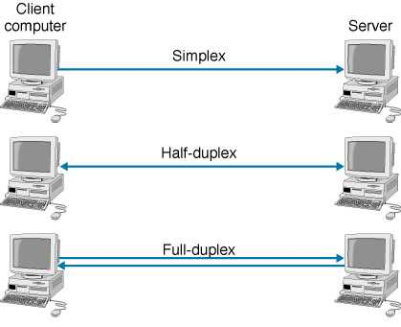
Types

Slide 16
Analog Signals
An analog signal is a smoothly and continuously varying voltage or current. Examples are:
Sine wave
Voice
Video (TV)

Slide 17
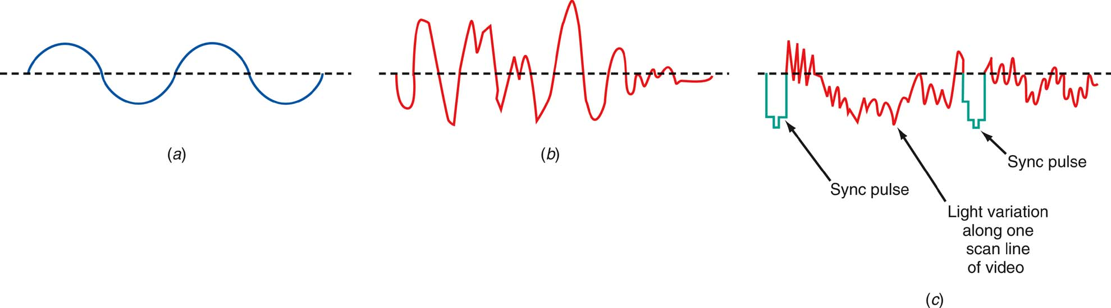
Analog signals
Figure : Analog signals (a) Sine wave “tone.” (b) Voice. (c) Video (TV) signal.

Slide 18
Digital Signals
Digital signals change in steps or in discrete increments.
Most digital signals use binary or two-state codes. Examples are:
Telegraph (Morse code)
Continuous wave (CW) code
Serial binary code (used in computers)

Slide 19
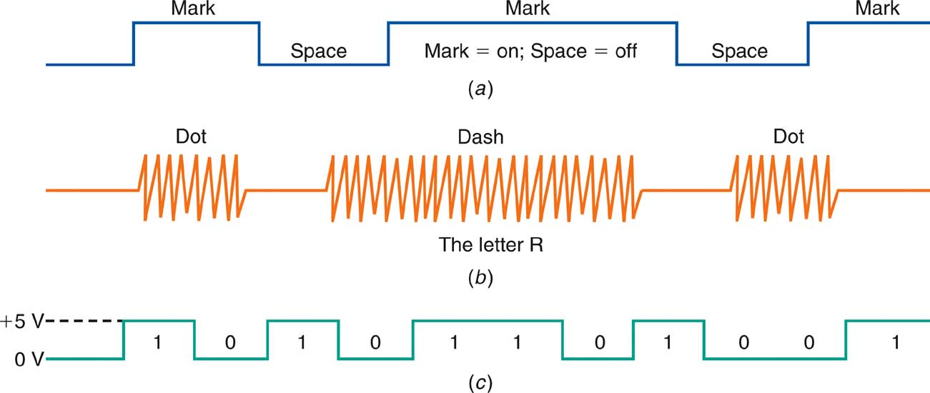
Digital Signals
Figure : Digital signals (a) Telegraph (Morse code). (b) Continuous-wave (CW) code. (c) Serial binary code.

Slide 20
Digital Signals
Many transmissions are of signals that originate in digital form but must be converted to analog form to match the transmission medium.
Digital data over the telephone network.
Analog signals.
They are first digitized with an analog-to-digital (A/D) converter.
The data can then be transmitted and processed by computers and other digital circuits.

Slide 21
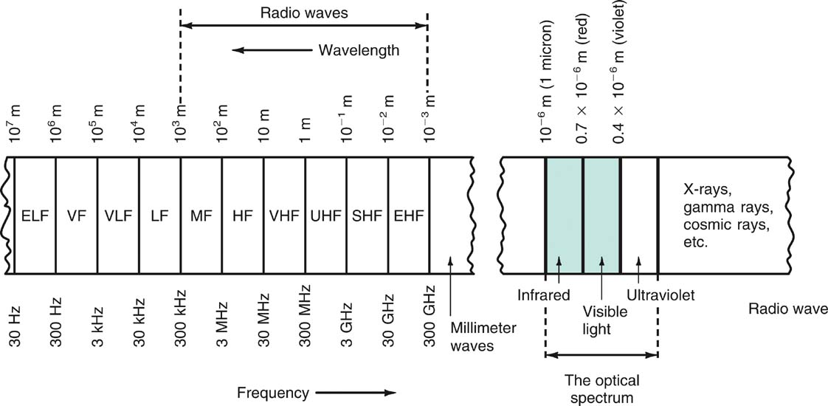
The Electromagnetic Spectrum
The range of electromagnetic signals encompassing all frequencies is referred to as the electromagnetic spectrum.
Figure : The electromagnetic spectrum.

Slide 22
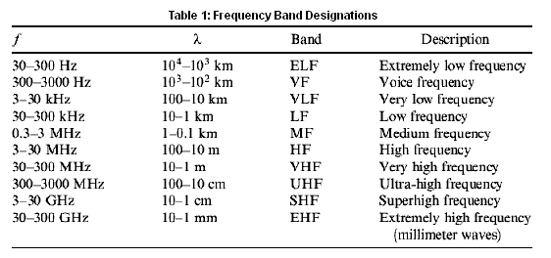

Slide 23
Frequency and Wavelength: Frequency
A signal is located on the frequency spectrum according to its frequency and wavelength.
Frequency is the number of cycles of a repetitive wave that occur in a given period of time.
A cycle consists of two voltage polarity reversals, current reversals, or electromagnetic field oscillations.
Frequency is measured in cycles per second (cps).
The unit of frequency is the hertz (Hz).

Slide 24
Frequency and Wavelength: Wavelength
Wavelength is the distance occupied by one cycle of a wave and is usually expressed in meters.
Wavelength is also the distance traveled by an electromagnetic wave during the time of one cycle.
The wavelength of a signal is represented by the Greek letter lambda (λ).

Slide 25
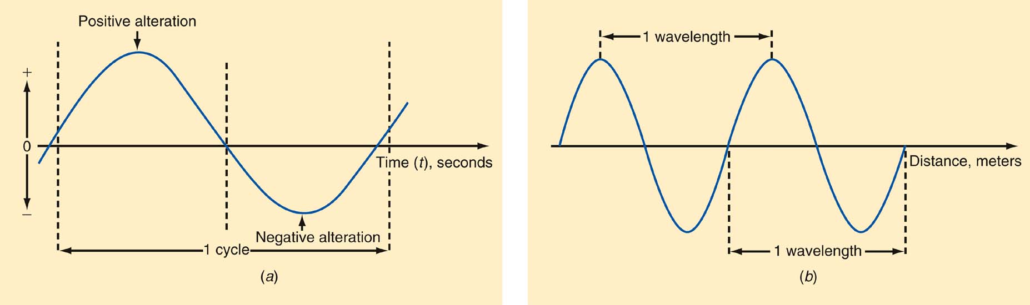
Frequency and Wavelength
Figure : Frequency and wavelength. (a) One cycle. (b) One wavelength.

Slide 26
Frequency Ranges from 30 Hz to 300 GHz
The electromagnetic spectrum is divided into segments:
Extremely Low Frequencies (ELF) | 30–300 Hz.
Voice Frequencies (VF) | 300–3000 Hz.
Very Low Frequencies (VLF) | include the higher end of the human hearing range up to about 20 kHz.
Low Frequencies (LF) | 30–300 kHz.
Medium Frequencies (MF) | 300–3000 kHz AM radio 535–1605 kHz.
20EC403 - Analog and Digital Communication

Slide 27
Frequency Ranges from 30 Hz to 300 GHz
High Frequencies (HF) (short waves; VOA, BBC broadcasts; government and military two-way communication; amateur radio, CB. | 3–30 MHz
Very High Frequencies (VHF) FM radio broadcasting (88–108 MHz), television channels 2–13. | 30–300 MHz
Ultra High Frequencies (UHF) TV channels 14–67, cellular phones, military communication. | 300–3000 MHz
20EC403 - Analog and Digital Communication

Slide 28
Frequency Ranges from 30 Hz to 300 GHz
Microwaves and Super High Frequencies (SHF) Satellite communication, radar, wireless LANs, microwave ovens | 1–30 GHz
Extremely High Frequencies (EHF) Satellite communication, computer data, radar | 30–300 GHz
20EC403 - Analog and Digital Communication

Slide 29
Bandwidth
Bandwidth (BW) is that portion of the electromagnetic spectrum occupied by a signal.
Channel bandwidth refers to the range of frequencies required to transmit the desired information.

Slide 30
Bandwidth
Spectrum Management and Standards
Spectrum management is provided by agencies set up by the United States and other countries to control spectrum use.
The Federal Communications Commission (FCC) and the National Telecommunications and Information Administration (NTIA) are two agencies that deal in spectrum management.
Standards are specifications and guidelines necessary to ensure compatibility between transmitting and receiving equipment.

Slide 31
Assessment Questions
Question #1
The EM wave has a Frequency of 5 kHz. Calculate the wavelength.
Question #2
How to interpret frequency in an analog clock?
Question #3
What are the common noise signals realized during lab experiments?

Slide 32
Solution
#1 f = c/λ, wavelength λ = 3 x10⁸ / 5 x 10³ = 60 km
Implication, a 5 kHz signal has a wavelength of 60 km.
(Very long distance)
#2 In Analog clocks, the second hand make 3600 rotation in one minute. The frequency of second hand is 360⁰/60⁰ = 60⁰. It is the distance traveled in per second.
#3 Interference from power supply is the common noise in lab experiments.
20EC403 - Analog and Digital Communication

Slide 33


